Slide 1
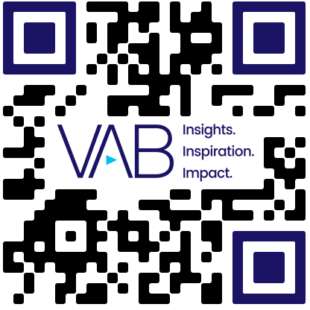
U.S. Economy Sentiment
Scan or click to access more economic insights
Consumers are split on whether the economy is in good or bad shape, which lends itself to continued uncertainty
Source: Dentsu, Consumer Navigator – American Mindset, Wave 51, April 2024.
Click here to see more on Dentsu’s ‘Consumer Navigator’
This information is exclusively provided to VAB members and qualified marketers.

