Slide 1
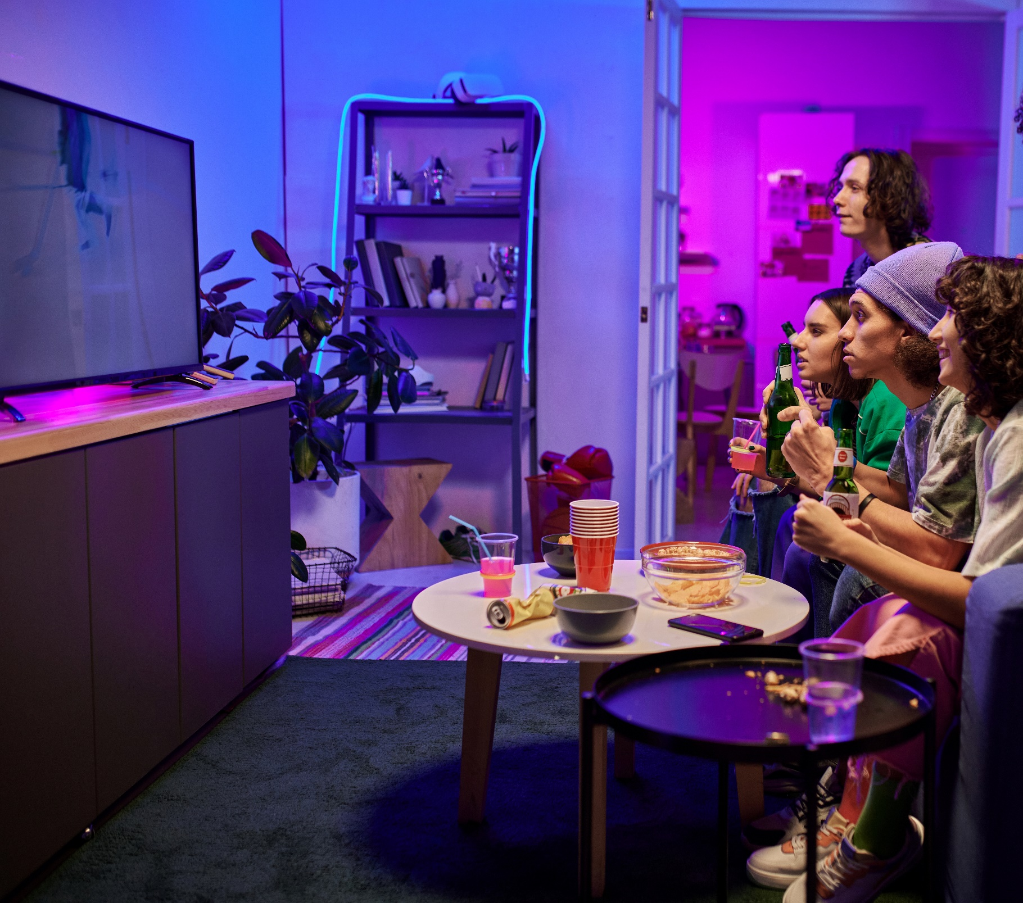
Gen Z: TV/Movies vs. Non-Premium Video Time Spent
Scan or click to access more Gen Z insights
Gen Z’s taste for rich storytelling and character development leads them to high-key spend more time with quality content
Hours per week spent watching TV & Movies vs. Non-Premium Videos Among P13-24 weekly non-premium video content viewers
Source: Hub Entertainment Research, Video Redefined, January 2024. Based on survey of 1,900 consumers, ages 13-74. P13-24 respondents = 620 (unweighted). Data collected December 2023. ‘Non-premium video’ includes short-form or user-generated video on YouTube, influencer video content, etc.
Click here to download the full report, ‘Laugh Cry, Share, Buy: How TV & Streaming Influences Gen Z More Than Leading Social Platforms’ to learn more
This information is exclusively provided to VAB members and qualified marketers.

