Slide 1
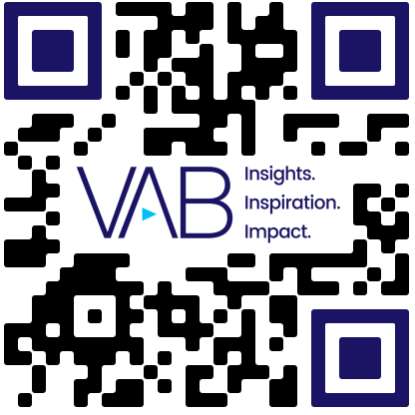
Political Ad Impact on Non-Political Ads
Scan or click to access more local advertising insights
50% of adults 21-35 pay more attention to non-political ads that air adjacent to political ads during the election season
Viewer attention impact during the presence of political ads
% of respondents who agree with the following statements
Segment | Yes, I pay more attention to any ads that aren't political | Yes, I pay more attention to all ads | No, I pay attention to most ads in the same way | Yes, I pay less attention to every ad I see | No, I never pay attention to any ads | I don't know
18-20 | 21% | 19% | 23% | 11% | 14% | 13%
21-35 | 23% | 27% | 23% | 11% | 9% | 7%
36-49 | 18% | 24% | 28% | 12% | 11% | 7%
50+ | 13% | 18% | 38% | 12% | 14% | 6%
Source: iSpot.tv, What Brands Need to Know About the Viewer Impact of Political Advertising, 9/12/24.
Click here to see more insights from iSpot.tv
theVAB.com/insights

