Slide 1
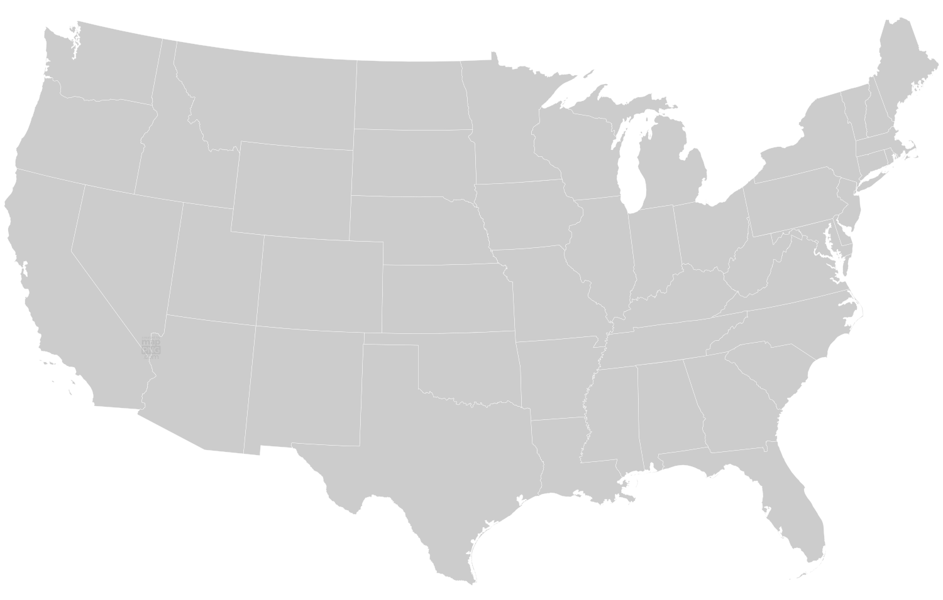
Streaming: Regional and Political Affiliation Preferences
Scan or click to access more political insights
Preference for streaming varies by region and political affiliation, unlocking opportunities for the 2024 election
CTV Users Who Prefer Watching Streaming TV by U.S. Region
vs. Cable/Satellite/Broadcast*
63%
Northeast
49%
West
60%
Midwest
65%
Dem
43%
Ind
62%
Rep
41%
Dem
66%
Ind
72%
Rep
68%
Dem
74%
Ind
67%
Rep
52%
of all viewers prefer streaming
(vs. traditional TV)*
Southwest
60%
Southeast
74%
Dem
60%
Ind
75%
Rep
47%
Dem
77%
Ind
77%
Rep
70%
Click here to see more from LG Ad Solutions
Source: LG Ad Solutions, The Big Shift: Political Edition, July 2024. *Among those who had a preference. Note: ‘Dem’ = Democrats, ‘Ind’ = Independents, ‘Rep’ = Republicans.
This information is exclusively provided to VAB members and qualified marketers.

