Slide 1

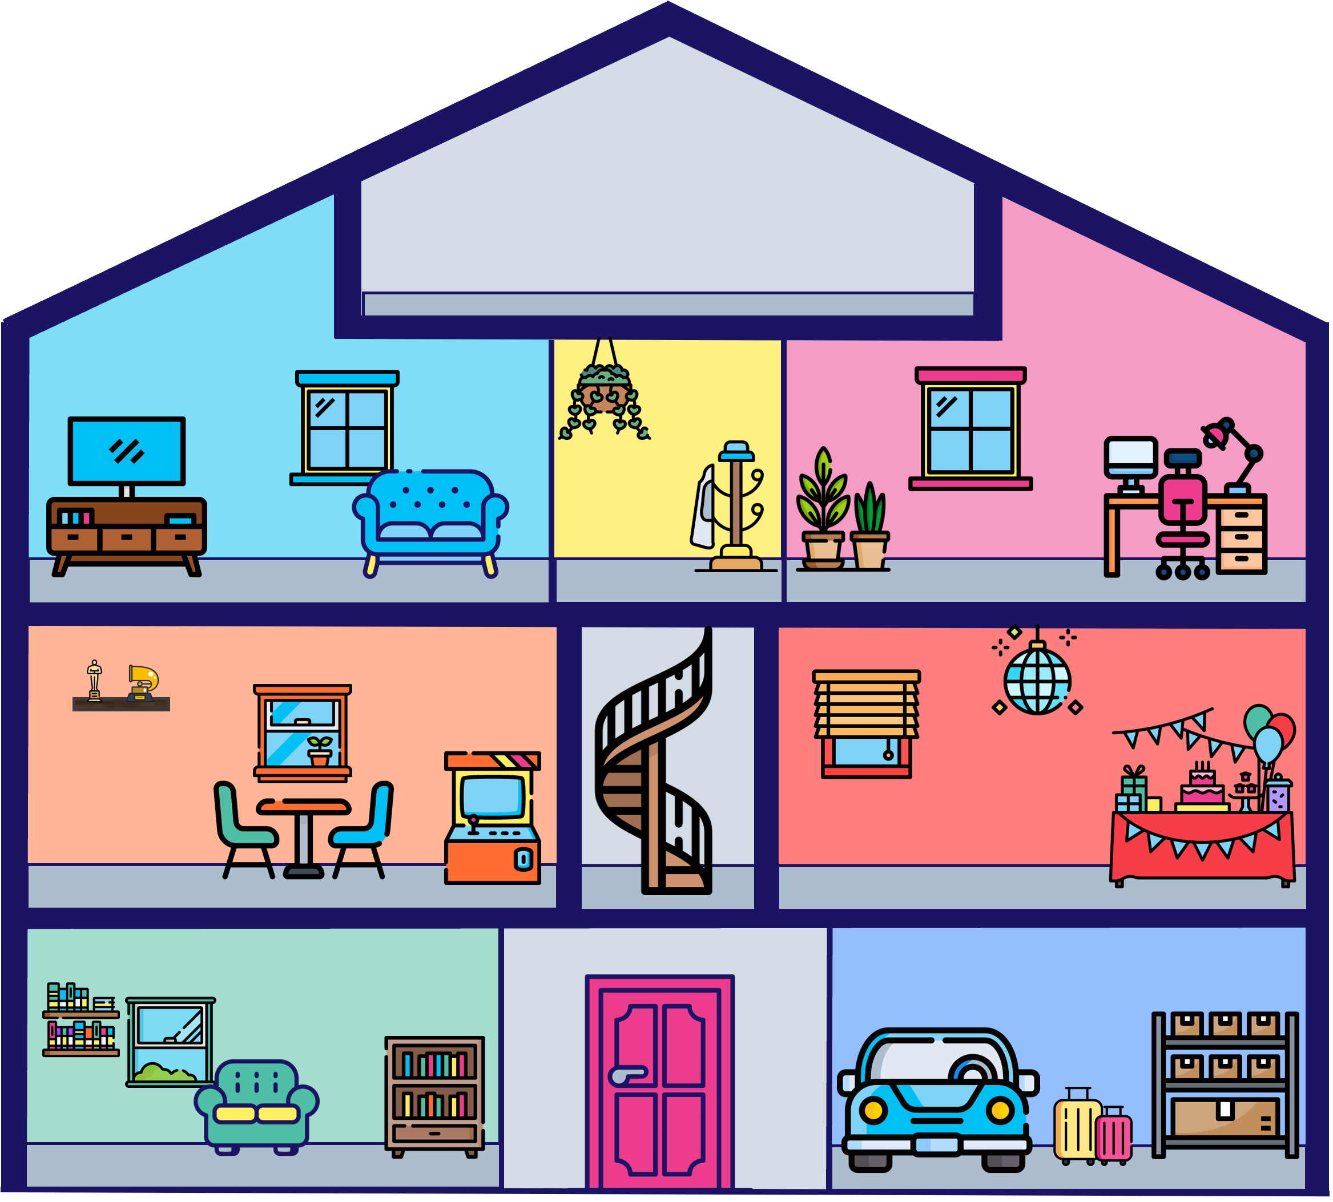








The Story of Us
How The Average American Spends Their Leisure Time Per Day
#1
Watching Video
2:40
(52%)
Total Daily Time spent:
5 Hours & 9 minutes
#7
Computer Use
for Leisure
0:12
(4%)
#9
Other
0:07
(2%)
#4
Playing Games
0:21
(7%)
#10
Arts & Entertainment
0:03
(1%)
#2
Socializing & Communicating
0:34
(11%)
#5
Sports, Exercise
& Recreation
0:20
(7%)
#3
Relaxing
0:23
(8%)
#6
Reading for
Personal Interest
0:15
(5%)
#8
Travel Related to Leisure & Sports
0:10
(3%)
Source: VAB Analysis of Bureau of Labor Statistics 2023 American Time Use Survey (P15+), conducted by U.S. Census Bureau. Note: Survey based on respondents' main activity only (e.g., if a respondent is watching TV while socializing with friends, the time would be attributed to whichever is deemed the 'primary activity' by the respondent). Figures Reflect Time Spent Per Day and Percentage of Daily Time Spent By Leisure Activity (5:09 Total), Time = (Hrs:Mins), # = Rank of leisure activity.

