Slide 1
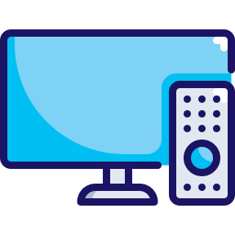
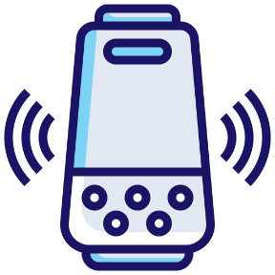
HH Penetration by Device
Scan or click to access more device usage insights
Homes are highly connected with most owning at least four devices, highlighting the importance of multiscreen strategies
Which of the following devices do you and other household members currently own?
93%
93%
74%
61%
TV
Smartphone
Laptop
Tablet
40%
42%
35%
Game Console
Desktop Computer
Smart Speaker
Click here to download the full report, ‘Left to Your Own Devices’ to learn more
Source: VAB analysis of ARF DASH study, full year 2023 vs. full year 2022. Based on survey of 10,000 A18+. Q3: Which of the following devices do you and other household members currently own? Based on household weighting.
This information is exclusively provided to VAB members and qualified marketers.

