Slide 1
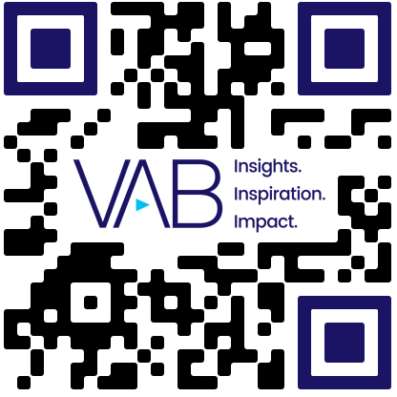
Diverse Representation in Streaming
Scan or click to access more diversity insights
Streaming films have greatly increased the representation of BIPOC lead actors over the last year
Lead Actor Race/Ethnicity in Streaming Films
U.S. BIPOC Population 44%
Source: UCLA, ‘Hollywood Diversity Report 2024, Part 2: Streaming’, May 2024. Note: BIPOC represents ‘Black, Indigenous, and People of Color’.
This information is exclusively provided to VAB members and qualified marketers.

