Slide 1
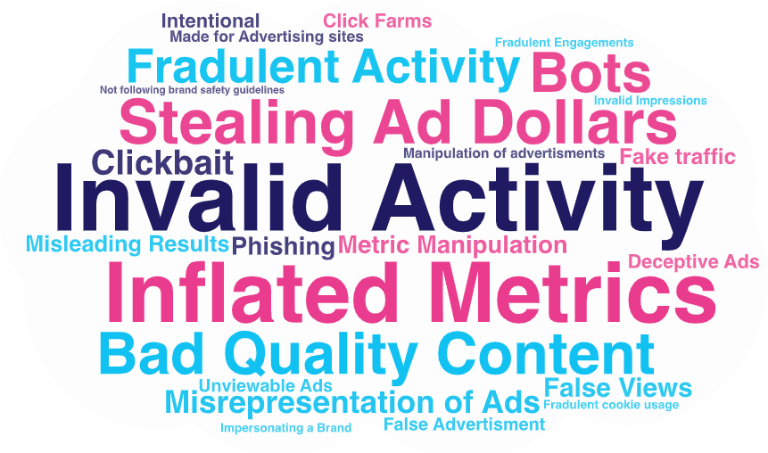
Ad Fraud Definitions
Scan or click to access more ad fraud insights
Agencies and brand marketers agree on the definition of ad fraud, with both equating it with some kind of ‘theft’
How marketers define ‘digital ad fraud’
Source: VAB / Advertiser Perceptions ‘Marketer Sentiment on Ad Fraud’ Survey, November 2023. Survey base: Marketer and agency contacts from the Advertiser Perceptions ‘Senior Marketer’ and ‘Streaming Video’ online communities. Q1A: What constitutes digital ad fraud? [open ended] Base = Total Respondents.
Click here to download the full report, ‘Exposed: 5 Inconvenient Truths We Learned From Marketers’ to learn more
This information is exclusively provided to VAB members and qualified marketers.

