Slide 1
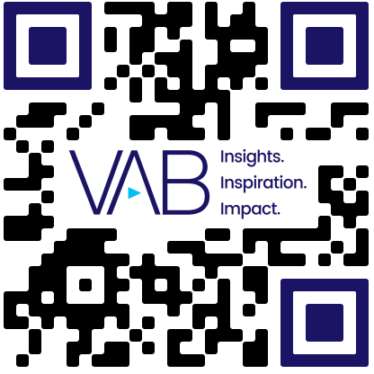
Bots: % of Total Web Traffic
Scan or click to access more ad fraud insights
Non-human bots now account for half of all web traffic with ‘harmful’ bot traffic representing almost one-third of total traffic
47.5%
49.6%
40.8%
42.3%
Source: Imperva, 2024 Bad Bot Report. Note: a ‘harmless bot’ is a software application that runs automated tasks to serve valuable functions, for instance indexing websites for search engines or monitoring website performance to help people find the most relevant sets of websites that match their queries. ‘Harmful bots’ are software applications that perform automated tasks with malicious intent. These bots can extract data from websites without permission to reuse it, they are often used for scalping tickets while some bad bots undertake criminal activities such as fraud and outright theft.
This information is exclusively provided to VAB members and qualified marketers.

