Slide 1
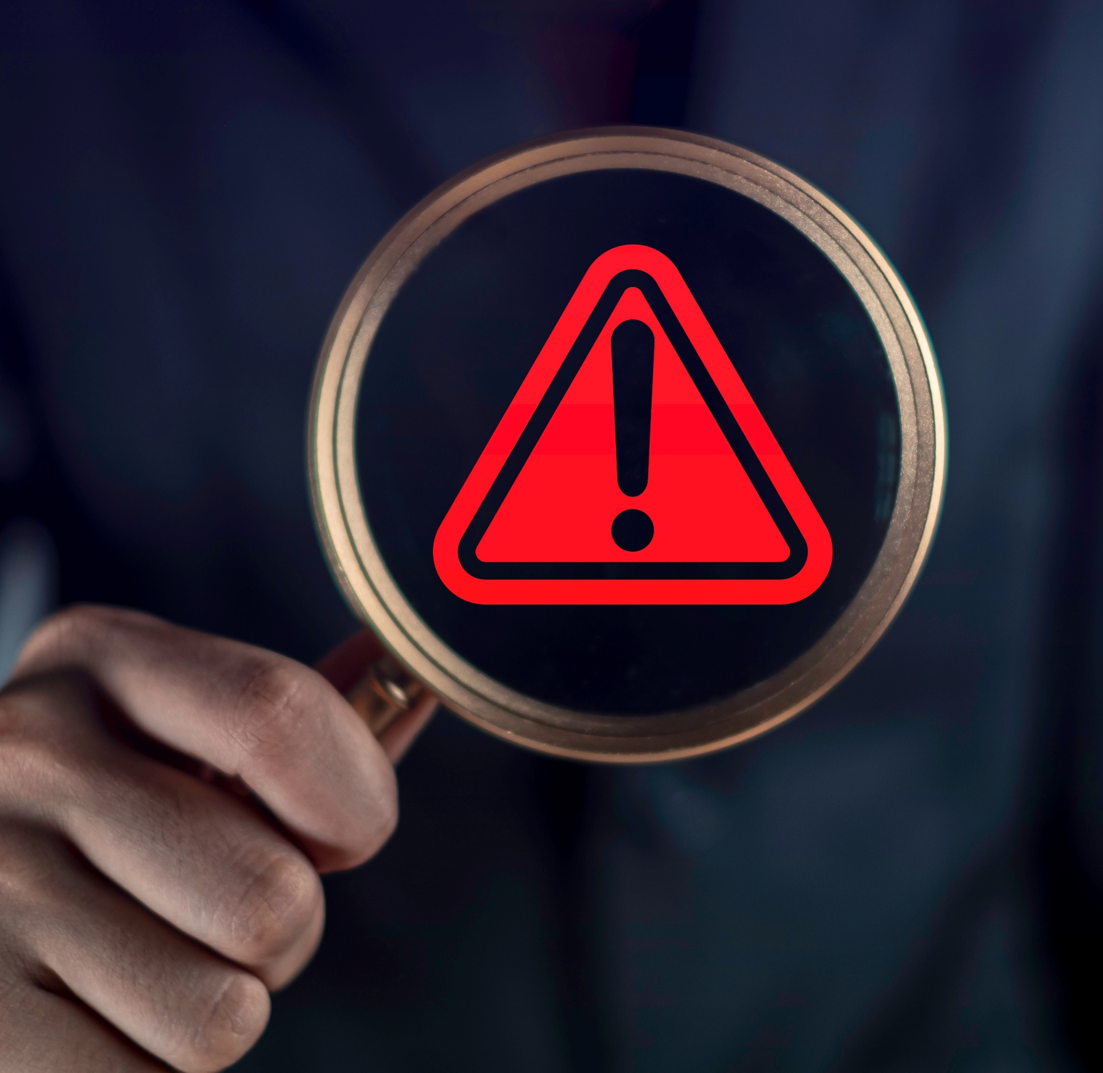
Brand Safe vs. Non-Brand Safe IMPs: Conversion Rates
Scan or click to access more brand safety insights
Beyond ethical and legal impacts of running in harmful content, brand safe ads have proven to drive superior conversion rates
+233%
lift in conversions for brand safe impressions vs. non brand safe impressions
Source: Integral Ad Science, Does Media Quality Drive Attention and Outcomes?, March 2022. Download VAB’s ‘What is Brand Safety’ to learn more.
Click here to download the full report, ‘Exposed: 5 Inconvenient Truths We Learned From Marketers’ to learn more
This information is exclusively provided to VAB members and qualified marketers.
PAGE 1

