Slide 1
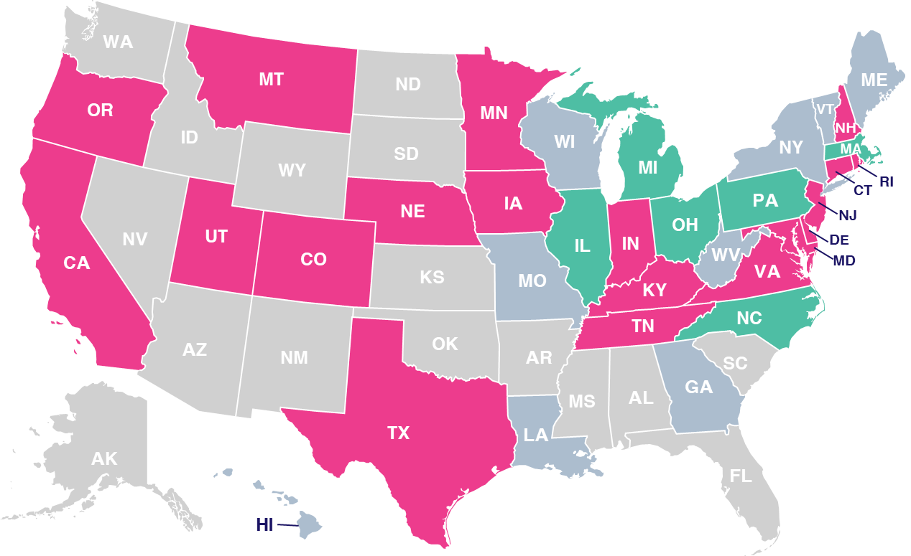
Data Privacy Map by State
Scan or click to access more data privacy insights
The data privacy landscape across the U.S. varies, with a number of new legislative acts being implemented by states
U.S. State Privacy Legislation Tracker
Legend
=Law Passed & Signed
(19 states)
=Active Bill In Committee
(6 states)
=Inactive Bill
(9 states)
=No Comprehensive Bill ..Introduced Yet
(16 states)
Click here to download the full report, ‘Understanding the Momentum of Data Privacy Legislation’ to learn more
Source: IAPP, ‘US State Privacy Legislation Tracker 2024,’ as of 7/8/24.
This information is exclusively provided to VAB members and qualified marketers.

