Slide 1
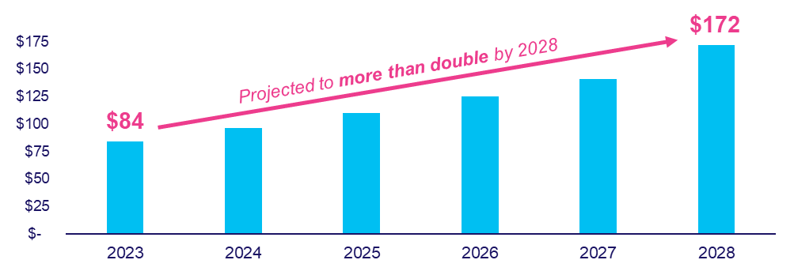
Cost of Digital Ad Fraud
Scan or click to access more ad fraud insights
The estimated global cost of digital ad fraud is $84 billion which is projected to more than double over the next 5 years
Estimated Global Cost of Digital Ad Fraud
$ in Billions
$35 billion projected in North America alone (2023)
$72 billion projected in North America alone (2028)
= to total U.S. national + local cable TV ad $$$
Source: Juniper Research, Quantifying the Cost of Ad Fraud: 2023-2028, 9/26/2023.
Click here to download the full report, ‘What Is… Digital Ad Fraud’ to learn more
This information is exclusively provided to VAB members and qualified marketers.

