Slide 1
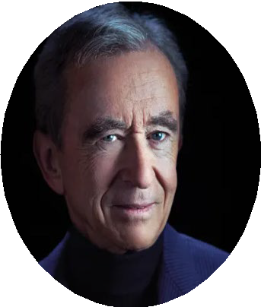
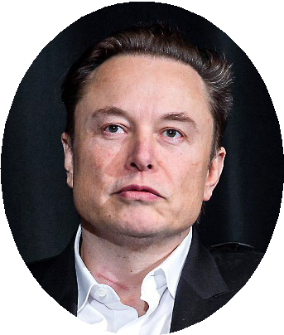
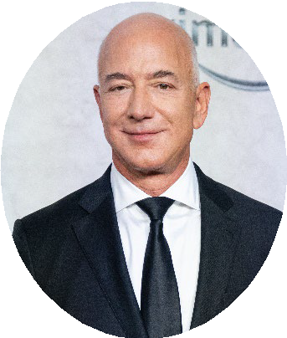
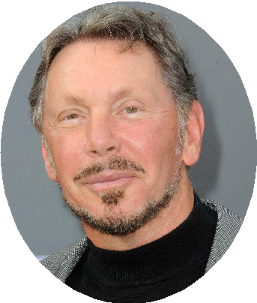
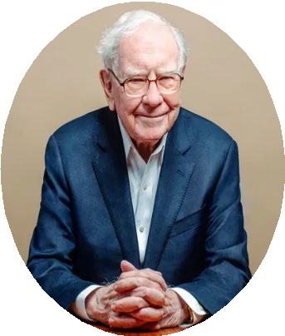
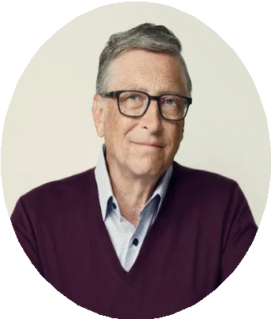
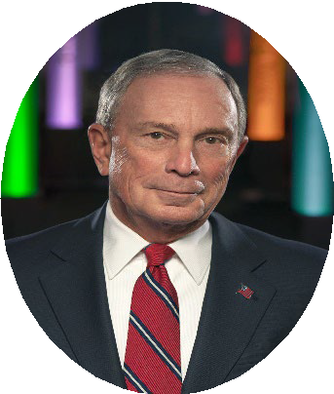
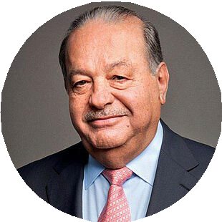
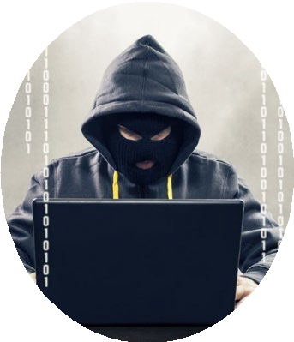
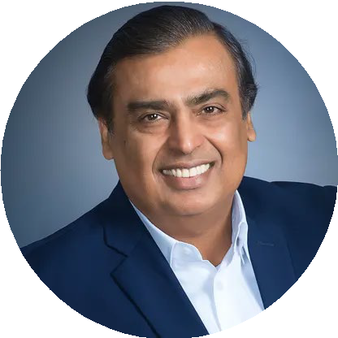
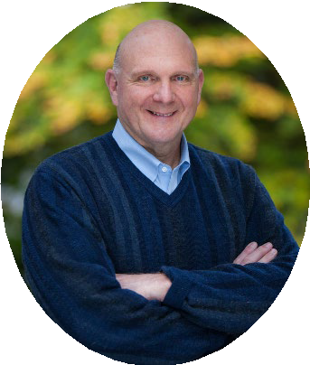
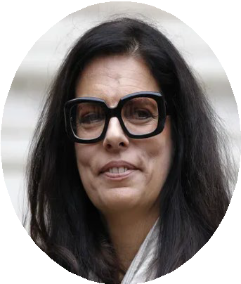
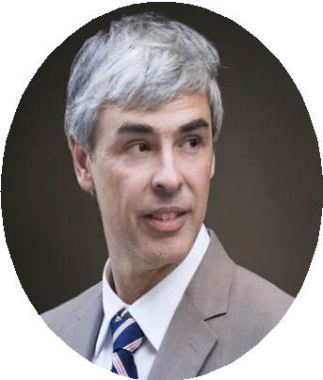
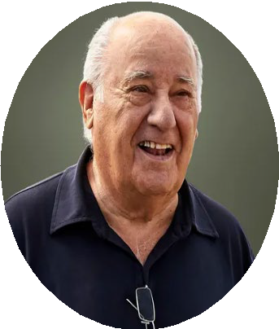
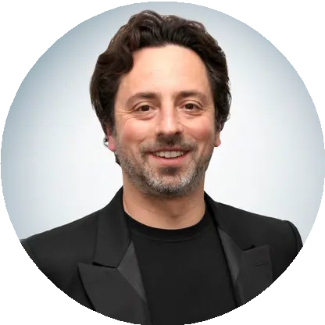
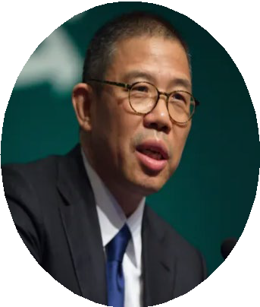
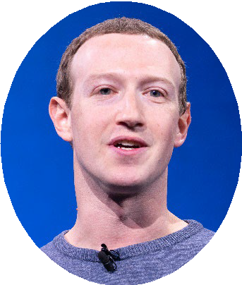
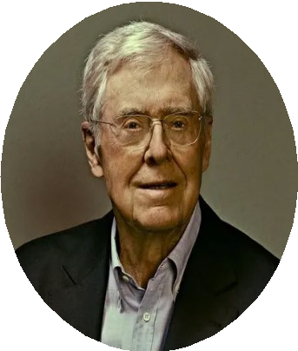
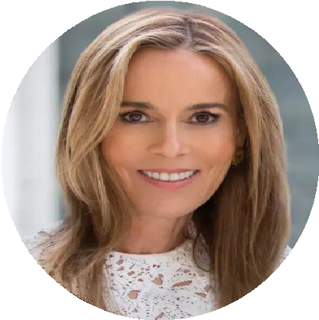
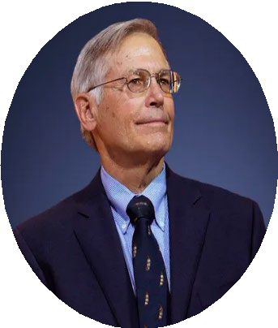
What If Digital Ad Fraud Was a Human?
Scan or click to access more ad fraud insights
If global digital ad fraud was a human, it would be the ninth richest person in the world
Net Worth of the Wealthiest People in the World vs. Global Cost of Digital Ad Fraud
in billions
Rank #2 Rank #3 Rank #4 Rank #5 Rank #6 Rank #7 Rank #8 Rank #9
Rank #1
Rank #10
Bernard Arnault & family $211B | Elon Musk $180B | Jeff Bezos $114B | Larry Ellison $107B | Warren Buffett $106B | Bill Gates $104B | Michael Bloomberg $95B | Carlos Slim Helú & family $93B | Ad Fraud* $84B | Mukesh Ambani $83B
Rank #11 | Rank #12 | Rank #13 | Rank #14 | Rank #15 | Rank #16 | Rank #17 | Rank #18t | Rank #18t | Rank #20
Steve Ballmer
$81B
Françoise Bettencourt Meyers & family
$81B
Larry Page | Amancio Ortega | Sergey Brin | Zhong Shanshan | Mark Zuckerberg | Charles Koch | Julia Koch | Jim Walton
$79B | $77B | $76B | $68B | $64B | $59B | $59B | $59B
Source: Forbes, The 25 Richest People In The World 2023, 4/4/2023. *Juniper Research, Quantifying the Cost of Ad Fraud: 2023-2028, 9/26/2023. *Includes Elon Musk (X/Twitter), Jeff Bezos (Amazon), Bill Gates & Steve Ballmer (Microsoft), Larry Page & Sergey Brin (Alphabet/Google), Mark Zuckerberg (Meta/Facebook)
Click here to download the full report, ‘Hidden Costs’ to learn more
This information is exclusively provided to VAB members and qualified marketers.

