Slide 1
July 25, 2024
Question of the Week:
“
As a marketer, how can I tap into the global excitement around women’s sports?
”

Slide 2
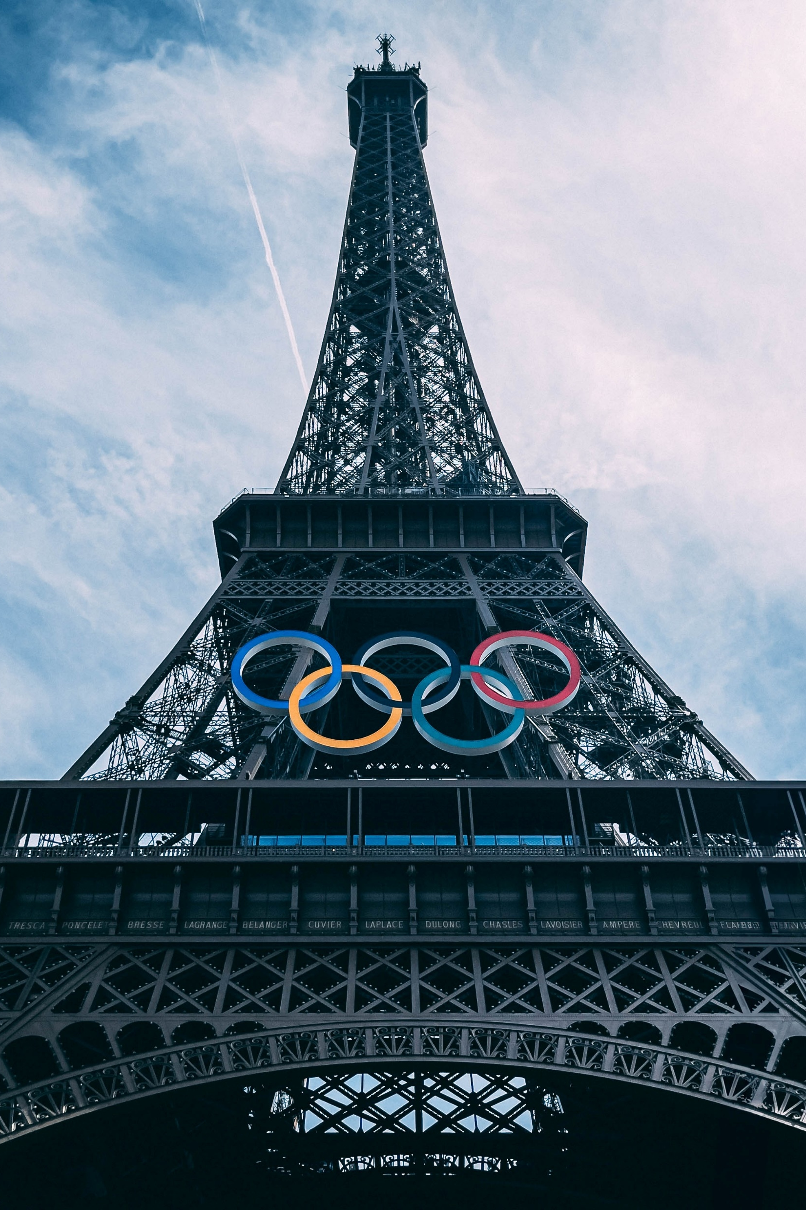
Answer: Align your brand with the sports, storylines and female athletes of the Summer Olympics
Viewership of women’s sports has skyrocketed in recent years, spurred by greater interest, more media coverage, increased competition and ‘marketable’ star athletes.
Through this growth, women’s sports have attracted highly desirable audiences for marketers.
Leveraging VAB custom research, this piece highlights
the popularity of women’s sports in the Summer Olympics, providing marketers a platform to reach valuable audiences across different ages and demographics in brand safe, live environments.
This information is exclusively provided to VAB members and qualified marketers.
PAGE 2

Slide 3
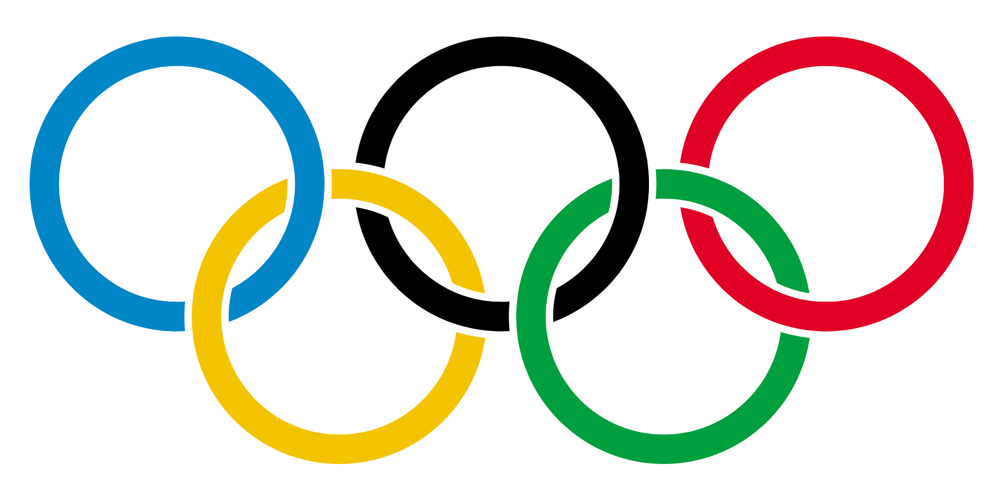
The Summer Olympics is the most popular event for viewers of all ages, both females and males, to watch women’s sports
% of those who watch the following women’s sports events on TV or streaming
% of sports viewers
Age 16+
Females 16+
Males 16+
Sport / Event
%
Sport / Event
%
Sport / Event
%
Summer Olympics
(gymnastics, track & field, swimming, etc.)
57%
Summer Olympics
(gymnastics, track & field, swimming, etc.)
60%
Summer Olympics
(gymnastics, track & field, swimming, etc.)
54%
Winter Olympics
(alpine skiing, figure skating, curling, etc.)
49%
Winter Olympics
(alpine skiing, figure skating, curling, etc.)
54%
Winter Olympics
(alpine skiing, figure skating, curling, etc.)
45%
FIFA Women’s World Cup
28%
FIFA Women’s World Cup
23%
FIFA Women’s World Cup
33%
Women's NCAA March Madness
23%
Women's NCAA March Madness
21%
Women's NCAA March Madness
24%
Women's Tennis Grand Slam
(Wimbledon, French Open)
20%
Women's Tennis Grand Slam
(Wimbledon, French Open)
18%
Women's Tennis Grand Slam
(Wimbledon, French Open)
21%
Source: VAB custom research fielded by Hub Entertainment Research as part of the 2023 Monetizing Video report. Data sourced from Hub’s survey of 1,602 consumers, self-identified active sports viewers (TV or streaming) ages 18-54 who meet the following criteria: watch at least one hour of TV / week, have broadband access. Data collected June 2023. VAB1: Do you watch the following women’s sport events on TV or streaming? Male and Female cuts. Note: excludes regular seasons of professional, collegiate and amateur sports leagues.
This information is exclusively provided to VAB members and qualified marketers.
PAGE 3

Slide 4
The Summer Olympics, as a stage to watch women’s sports, is particularly popular among Gen Z and young Millennials
% of those who watch the following women’s sports events on TV or streaming
% of sports viewers
Adults 16-34
Males 16-34
Females 16-34
Sport / Event
%
Sport / Event
%
Sport / Event
%
Summer Olympics
(gymnastics, track & field, swimming, etc.)
44%
Summer Olympics
(gymnastics, track & field, swimming, etc.)
41%
Summer Olympics
(gymnastics, track & field, swimming, etc.)
47%
Winter Olympics
(alpine skiing, figure skating, curling, etc.)
33%
Winter Olympics
(alpine skiing, figure skating, curling, etc.)
32%
Winter Olympics
(alpine skiing, figure skating, curling, etc.)
35%
FIFA Women’s World Cup
27%
FIFA Women’s World Cup
27%
FIFA Women’s World Cup
27%
Women's NCAA March Madness
23%
WNBA Playoffs
26%
Women's NCAA March Madness
24%
21%
Women's NCAA March Madness
22%
Women's Tennis Grand Slam
(Wimbledon, French Open)
17%
WNBA Playoffs
Source: VAB custom research fielded by Hub Entertainment Research as part of the 2023 Monetizing Video report. Data sourced from Hub’s survey of 1,602 consumers, self-identified active sports viewers (TV or streaming) ages 18-54 who meet the following criteria: watch at least one hour of TV / week, have broadband access. Data collected June 2023. VAB1: Do you watch the following women’s sport events on TV or streaming? Male and Female cuts. Note: excludes regular seasons of professional, collegiate and amateur sports leagues.
This information is exclusively provided to VAB members and qualified marketers.
PAGE 4

Slide 5
Women’s sports within the Summer Olympics also resonates highly among affluent households, families and cord cutters who stream
% of those who watch the following women’s sports events on TV or streaming
% of sports viewers
Household Income $100K+
Households with Kids
Cord Cutters / Nevers
Sport / Event
%
Sport / Event
%
Sport / Event
%
Summer Olympics
(gymnastics, track & field, swimming, etc.)
65%
Summer Olympics
(gymnastics, track & field, swimming, etc.)
51%
Summer Olympics
(gymnastics, track & field, swimming, etc.)
62%
Winter Olympics
(alpine skiing, figure skating, curling, etc.)
58%
Winter Olympics
(alpine skiing, figure skating, curling, etc.)
41%
Winter Olympics
(alpine skiing, figure skating, curling, etc.)
49%
FIFA Women’s World Cup
35%
FIFA Women’s World Cup
37%
FIFA Women’s World Cup
26%
Women's Tennis Grand Slam
(Wimbledon, French Open)
25%
Women's Tennis Grand Slam
(Wimbledon, French Open)
24%
Women's NCAA March Madness
23%
Women's NCAA March Madness
23%
Women's NCAA March Madness
23%
Women's Tennis Grand Slam
(Wimbledon, French Open)
18%
Source: VAB custom research fielded by Hub Entertainment Research as part of the 2023 Monetizing Video report. Data sourced from Hub’s survey of 1,602 consumers, self-identified active sports viewers (TV or streaming) ages 18-54 who meet the following criteria: watch at least one hour of TV / week, have broadband access. Data collected June 2023. VAB1: Do you watch the following women’s sport events on TV or streaming? Household cuts. Note: excludes regular seasons of professional, collegiate and amateur sports leagues.
This information is exclusively provided to VAB members and qualified marketers.
PAGE 5

Slide 6
Download our full report below to learn more about the rising popularity of women’s sports and the opportunities that exist for brands
Click report cover below to download
This information is exclusively provided to VAB members and qualified marketers.
PAGE 6

Slide 7
About VAB
VAB plays a dual role in the video advertising industry. We are leading the change to bring about a more innovative and transparent marketplace. We also provide the insights and thought leadership that enables marketers to develop business-driving marketing strategies.
Drawing on our marketing expertise, we simplify the complexities in our industry and discover new insights that transform the way marketers look at their media strategy.
We are committed to your business growth and proud to offer VAB members, brand marketers and agencies complimentary access to our continuously-growing Insights library. Get immediate access at theVAB.com.
This information is exclusively provided to VAB members and qualified marketers.
PAGE 7

