Slide 1
September 13, 2024
Question of the Week:
“
Are there potential risks associated with incentives provided by digital platforms?
”

Slide 2
Media buy incentives provided by digital platforms are a common practice which can include pricing discounts, free media and rebate programs
Top Incentives Received
% of total respondents
Discounts on standard pricing
Free media & impressions
Access to innovative products*
Access to exclusive premium inventory
85%
of marketers receive some kind of incentive from their digital campaign partners
62%
38%
38%
38%
Campaign assistance**
Educational training programs
Rebate programs / cash payments
38%
21%
15%
Source: VAB / Advertiser Perceptions ‘Marketer Sentiment on Ad Fraud’ Survey, November 2023. Survey base: Marketer and agency contacts from the Advertiser Perceptions ‘Senior Marketer’ and ‘Streaming Video’ online communities. Q4. Are [you/your clients] incentivized by digital campaign partners in any of the following ways? Base = Total Respondents. *e.g., generative AI tools, etc. **e.g., access to proprietary research, on-site consultation.
This information is exclusively provided to VAB members and qualified marketers.
PAGE 2

Slide 3
Incentives from digital platforms can appeal to marketers and agencies for cost savings but may risk compromising quality and transparency
Marketers and agencies have different reasons to push for lower costs including pressure from procurement or KPI directives from clients
69%
of brand marketers and agency professionals do not prioritize brand safety over lower CPMs
Source: VAB / Advertiser Perceptions ‘Marketer Sentiment on Ad Fraud’ Survey, November 2023. Survey base: Marketer and agency contacts from the Advertiser Perceptions ‘Senior Marketer’ and ‘Streaming Video’ online communities. Q6. What solutions [is your company/are your clients] using to prevent digital ad fraud? Base = Total Respondents.
This information is exclusively provided to VAB members and qualified marketers.
PAGE 3

Slide 4
What are some of the risks that could be unknowingly tied to digital media buy incentives that marketers should be aware of?

Slide 5
Recent reports have raised concerns about practices related to incentives with digital platforms, especially for small and medium businesses
8/26/24
9/3/24
Google Sought to Pay Agencies Hundreds
of Millions to Sway Media Buys
Antitrust documents detail how Google planned to incentivize agencies in 2018
Agencies Continue to Receive Perks From Media Owners That Aren't Disclosed to Clients
Misaligned incentives can lead to wasted media spend
Arielle Garcia, director of intelligence at industry watchdog Check My Ads, who formerly worked at ad-buying giant UM, described the program as benefitting Google. Garcia has first-hand knowledge of Google’s program, she said.
“[Google] tends to recommend things that benefit themselves more so than advertisers,” Garcia said.
Incentive programs between large media companies and agencies continue to lead to poor advertising decisions and less transparency for smaller clients, 10 sources from agencies, brands, and publishers told ADWEEK.
Small and medium-sized clients were less likely to have stipulations in their contracts with agencies to ensure incentive programs are disclosed, the first buyer source said.
Medium-sized buyers would spend more with Google, “and then the rebates would come and they would typically go back to the agency or go back to the bigger clients,” the first buyer said.
What makes Google completely different “to another publisher or media vendor that participates in upfront negotiations is that the universe that you can transact through Google’s platform is endless,” the media auditor source said.
For instance, to fulfill a minimum spend commitment under an incentive program with a TV company, there are a finite number of shows in which agencies can buy airtime. But with Google, much more inventory is on the table, making it more likely brands don’t know which exact Google media their agency is buying, the source continued.
This information is exclusively provided to VAB members and qualified marketers.
PAGE 5

Slide 6
Separately, a study by researchers at Adalytics claimed advertisers may be paying premium pricing for non-premium placements on digital platforms
Distribution for YouTube TrueView In-stream Ad Campaign Budget Spend on YouTube vs. Google Video Partner (GVP) Network
Major Infrastructure Brand
GVP Mobile App
Valid TrueView
Valid Placements
27% of YouTube buy spend were ‘valid TrueView, skippable, in-stream video ads’
GVP Webpage
Valid TrueView
YouTube Channel
Valid TrueView
GVP Webpage
Invalid TrueView
Invalid Placements
73% of YouTube buy spend was misrepresented as ‘valid TrueView, skippable, in-stream video ads’ when they were not
GVP Mobile Application
Invalid TrueView
Source: Adalytics Research LLC, ‘Did Google Mislead Advertisers About TrueView Skippable In-Stream Ads for the Past Three Years?’ report, June 2023. Note: after the Adalytics report was released, YouTube changed the name of their ‘in-stream ads’ format to ‘skippable ads’ throughout Google Display and Video 360, according to a ‘What’s New: July 2023’ Google Blog Post and reported by Adweek on 8/7/23.
This information is exclusively provided to VAB members and qualified marketers.
PAGE 6

Slide 7
Major digital platforms offer audience network extensions but the lack of transparency around these websites can cause brand safety concerns
Audience Networks (aka Audience Extensions)
A way to expand the reach of a digital campaign with a single publisher by using cookies to identify and track user’s activity on other websites/apps and then serving ads to the same audiences on those 3rd party websites/apps.
Examples of Audience Networks
‘Partners are publisher websites and mobile apps where you can show your video ads to viewers beyond YouTube’
‘Extends Meta's people-based advertising beyond the Facebook app’
‘Gain access to Pangle’s vast network of mobile apps’
‘Delivers ads beyond the LinkedIn feed to members on trusted third-party apps and sites’
‘Ad placements are cross-device and include premium sites like MSN, Outlook.com, Microsoft Edge, and other partners’
Google Video Partners Network
Meta Audience Network
Pangle (TikTok)
LinkedIn Audience Network
Microsoft Audience Network
Source: Google Ads Help, About Google video partners’ Meta Business Help Center, How Meta Audience Network works; Pangle, How to level up your ad campaign on Pangle; LinkedIn Help, LinkedIn Audience Network FAQs; Microsoft Advertising Help, About Microsoft Audience Ads; To learn more about terminology and facts around digital advertising, click the link to download ‘What Is Digital Ad Fraud’
This information is exclusively provided to VAB members and qualified marketers.
PAGE 7

Slide 8
Audience networks can include several ‘Made for Advertising’ websites, which creates negative brand associations and wasted ad dollars
4,500+
“The most problematic are going to be display ads shown on a variety of third-party websites. All of those individual website owners, publishers are actually incentivized to engage in fraudulent activity.”
projected number of existing ‘Made for Advertising’ Sites*
CMO, Consumer Electronics Category (Anonymous)
$10B estimated annual global advertising spend
Source: VAB / Advertiser Perceptions ‘Marketer Sentiment on Ad Fraud’ Survey, based on in-depth interviews, fielded October 2023. Survey base: Marketer and agency contacts from the Advertiser Perceptions ‘Senior Marketer’ and ‘Streaming Video’ online communities. *ANA (Association of National Advertisers), Programmatic Media Supply Chain Transparency Study – Complete Report, December 2023. To learn more about terminology and facts around digital advertising, click the link to download ‘What Is Digital Ad Fraud’
This information is exclusively provided to VAB members and qualified marketers.
PAGE 8

Slide 9
A lack of campaign buy transparency can also mean that video ads may play in poor environments which can devalue brands
Examples of video ads running in subpar placements
In a small corner or side of a page
In a fully muted video player
With little to no video content between consecutive ads
‘Auto-plays’ without any user interaction or initiation
Ad plays continuously on a loop
Multiple video ads playing simultaneously on the same page
The ‘skip’ button on a video ad is hidden or obscured
Runs out of sight while the audio plays
Ads served “stacked” on top of another ad
This information is exclusively provided to VAB members and qualified marketers.
PAGE 9

Slide 10
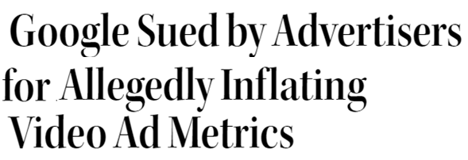
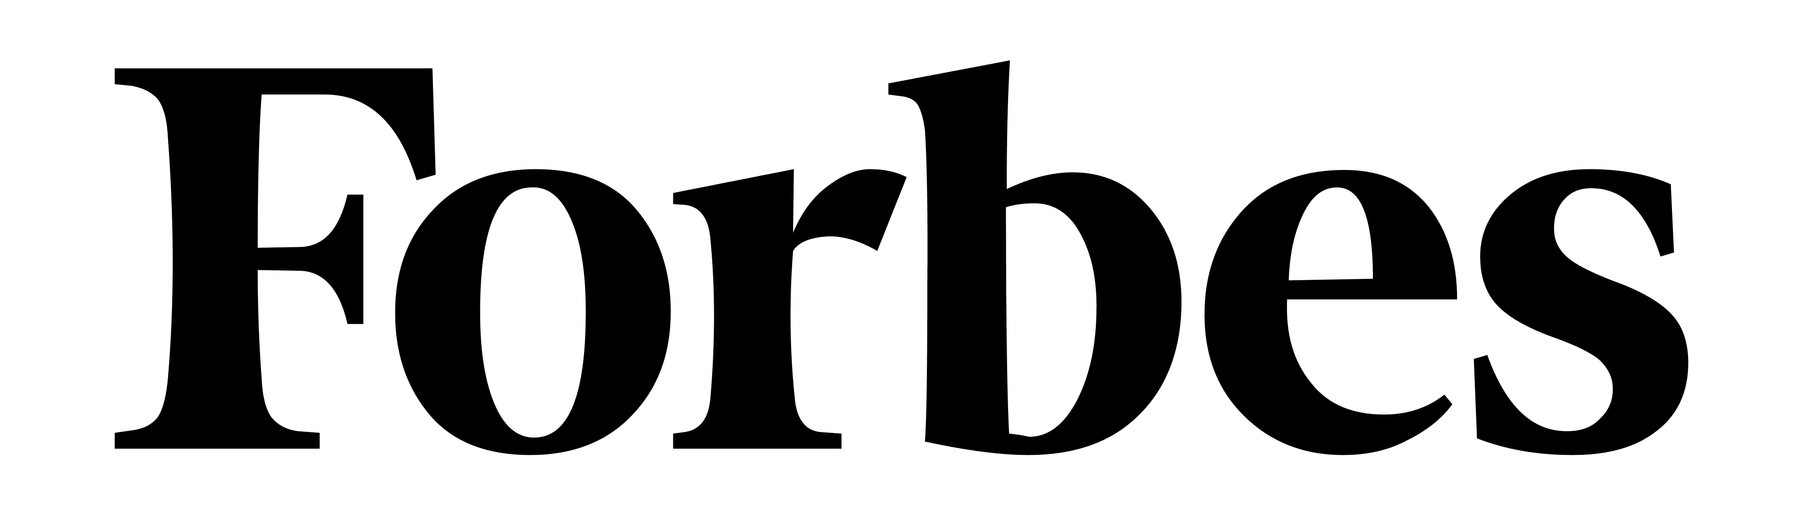
A lack of transparency can also lead to alleged fraudulent advertising activities, including metric inflation and ad placement misrepresentation
April 2, 2024
July 26, 2023
June 27, 2023
March 29, 2024
June 28, 2023
December 15, 2023
August 20, 2018
November 28, 2023
July 11, 2023
February 19, 2021
This information is exclusively provided to VAB members and qualified marketers.
PAGE 10

Slide 11
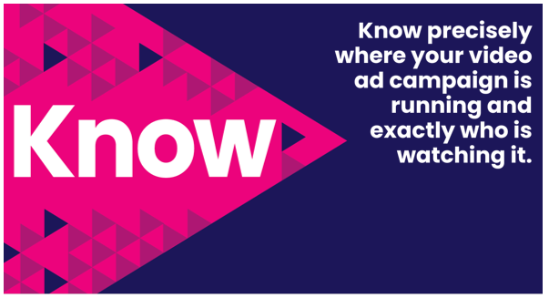
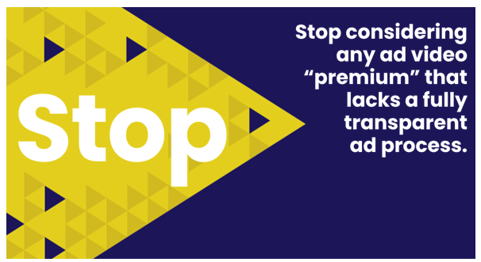
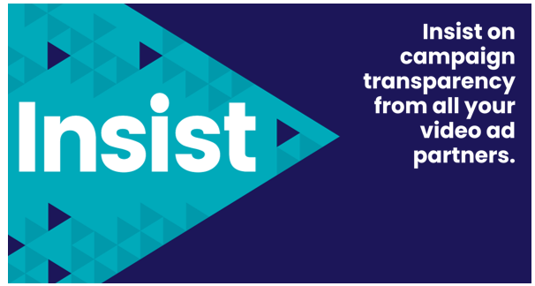
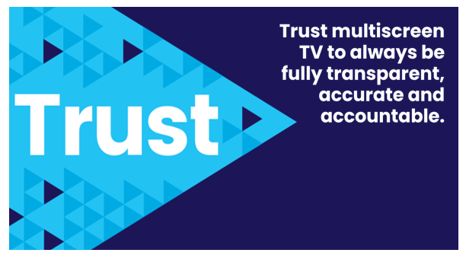
Adults over 50 account for 36% of the total population and nearly half of all adults
Marketers can protect the integrity of their digital campaign buys by taking an active role in demanding transparency across all their media & verification partners
Also, the FreeWheel Council for Premium Video and the VAB have partnered to advocate for the value of premium standards. Click below to download and learn more!
Buying Premium Video: A Definitive Checklist
This information is exclusively provided to VAB members and qualified marketers.
PAGE 11

Slide 12
Adults over 50 account for 36% of the total population and nearly half of all adults
Media buy incentives from digital partners may sometimes favor the platform's goals over the advertiser’s objectives which can affect campaign choices
Lack of campaign transparency with digital partners can lead to ads appearing in poor environments and placements that were unknown to marketers which can impact brand safety
Even if they receive incentives like discounts, free media or rebates for their ad investments, marketers should seek full transparency from their media partners to protect against brand safety risks and ensure the campaign is supporting their overall business objectives
Key Marketer Takeaways
This information is exclusively provided to VAB members and qualified marketers.
PAGE 12

Slide 13
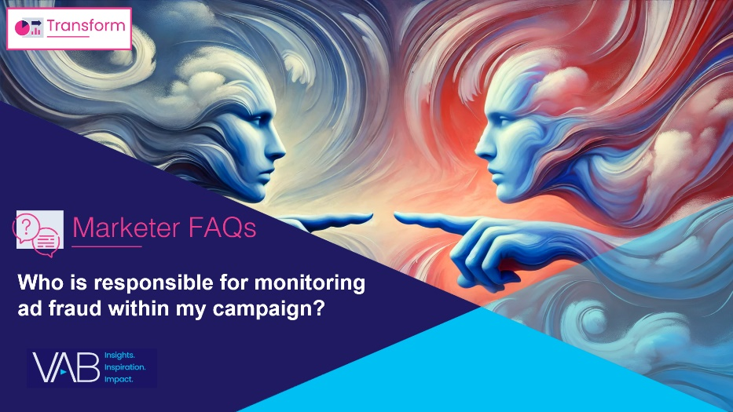
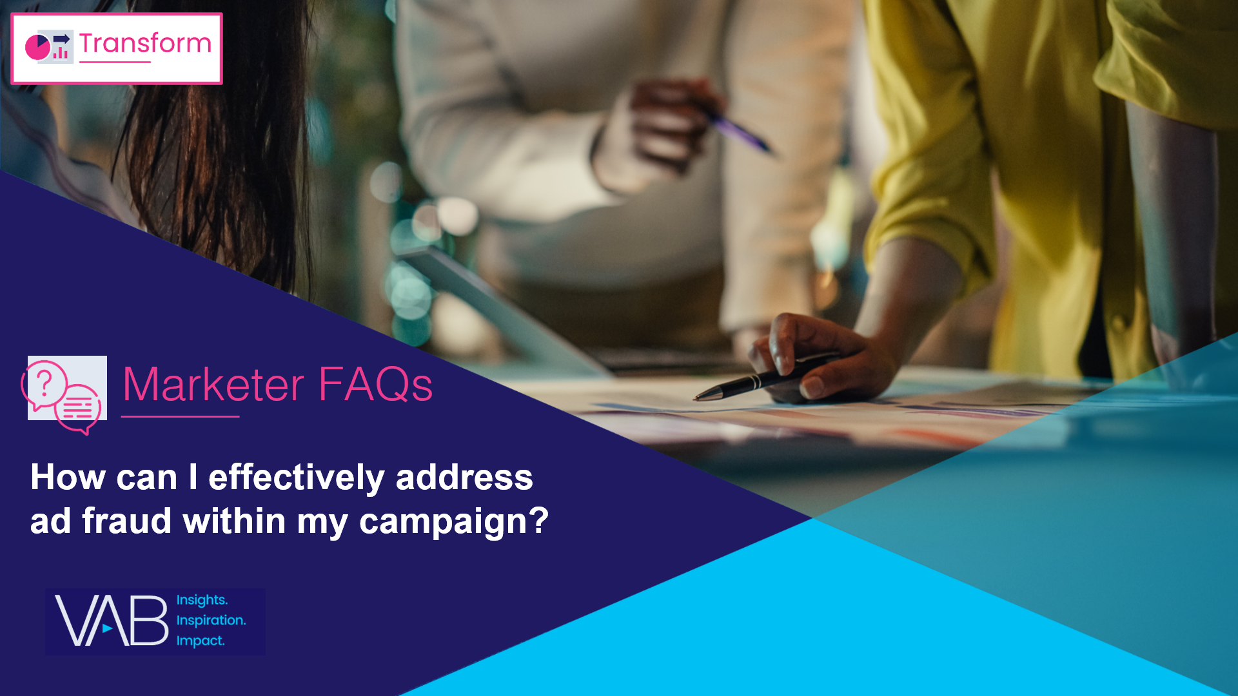
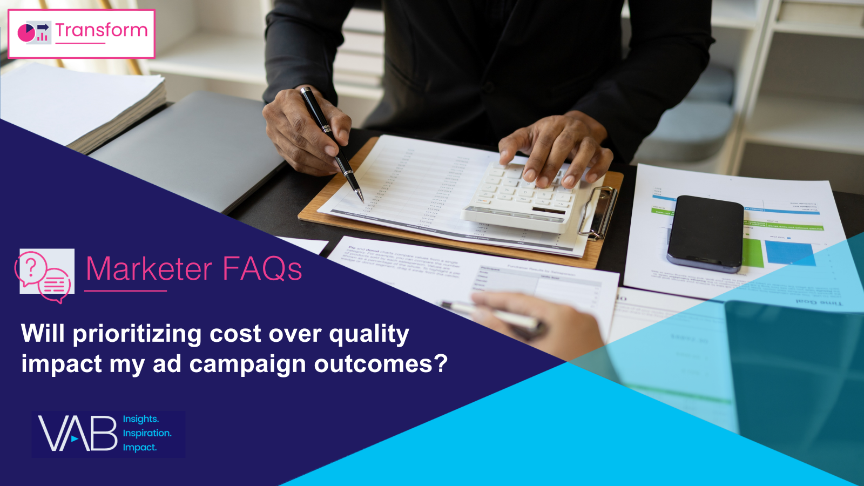
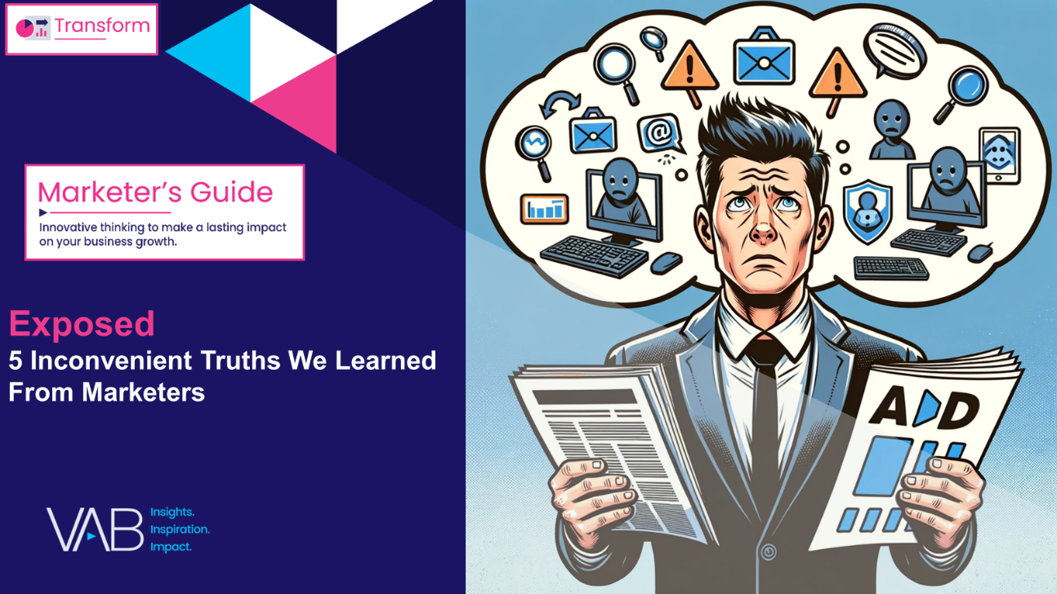
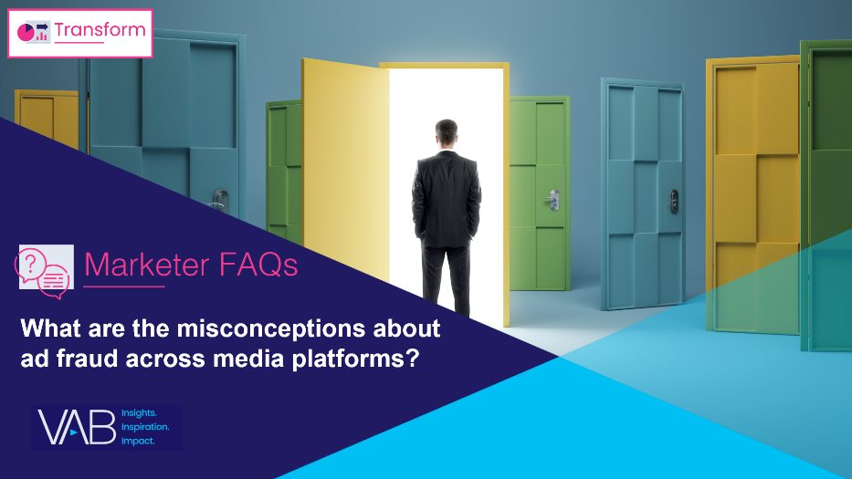
Download these other VAB resources from our ‘Exposed’ marketer’s guide to understand marketers’ views on transparency and brand safety in media
Other ‘Exposed’ Marketer FAQs
Full 51-page custom survey of marketers and agency professionals on the common misconceptions and misunderstandings around transparency, ad fraud and brand safety
Who is responsible for monitoring ad fraud within my campaign?
How can I effectively address ad fraud within my campaign?
Will prioritizing cost over quality impact my ad campaign outcomes?
Click to Download
What are the misconceptions about ad fraud across media platforms?
Does ad fraud pose any risks beyond affecting my campaign metrics?
This information is exclusively provided to VAB members and qualified marketers.
PAGE 13

Slide 14
About VAB
VAB plays a dual role in the video advertising industry. We are leading the change to bring about a more innovative and transparent marketplace. We also provide the insights and thought leadership that enables marketers to develop business-driving marketing strategies.
Drawing on our marketing expertise, we simplify the complexities in our industry and discover new insights that transform the way marketers look at their media strategy.
We are committed to your business growth and proud to offer VAB members, brand marketers and agencies complimentary access to our continuously-growing Insights library. Get immediate access at theVAB.com.
This information is exclusively provided to VAB members and qualified marketers.
PAGE 14

Slide 15
To learn what marketers think about advertising transparency, ad fraud and brand safety we conducted independent research
VAB’s custom study results are based on responses from senior brand marketers and high-level agency professionals. These individuals are part of Advertiser Perceptions’ Insights Community, a distinguished panel of industry experts who are deeply experienced and constantly tuned into the latest trends and developments.
Their keen awareness and understanding of the ever-evolving advertising landscape make them uniquely positioned to identify the industry's most pressing challenges.
Part I: in-depth interviews of 5 select respondents
September 26 – October 2, 2023
Part II: quantitative survey of 39 respondents
November 10 - 14, 2023
Respondent Qualifications:
Senior level decision-makers involved in digital video, CTV and / or linear TV campaigns
Mix of category verticals
Mix of annual media spend levels
Senior job level / title
This information is exclusively provided to VAB members and qualified marketers.
PAGE 15

