Slide 1
October 4, 2024
Question of the Week:
“
How can I improve cybersecurity in both my professional and personal life?
”

Slide 2
Cybersecurity Defined
Cybersecurity is:
The art of protecting networks, devices, and data from unauthorized access or criminal use while ensuring confidentiality, integrity, and availability of information.
Source: Cybersecurity & Infrastructure Security Agency, What is Cybersecurity, 2/1/2021
This information is exclusively provided to VAB members and qualified marketers.
PAGE 2

Slide 3
Cybercrime Defined
Cybercrime is:
Including but not limited to…
Damage and destruction of data
Stolen money
Lost productivity
Theft of intellectual property
Theft of personal and financial data
Embezzlement
Fraud
Deletion of hacked data and systems
Any criminal activity that involves a computer, network or networked device.
Source: Cyber Crime Magazine, Top 10 Cybersecurity Predictions and Statistics For 2024, 2/5/2024
This information is exclusively provided to VAB members and qualified marketers.
PAGE 3

Slide 4
In 2023…
every
39
seconds
… a cybercrime took place
Source: Cyber Security Ventures, 2023
This information is exclusively provided to VAB members and qualified marketers.
PAGE 4

Slide 5
In 2023…
880,000+
… complaints about cybercrime
were sent nationwide
Source: Cyber Security Ventures, 2023
This information is exclusively provided to VAB members and qualified marketers.
PAGE 5

Slide 6
Cybercrime is big business and only expected to grow, with the global cost projected to increase by 50% from 2024 to 2028
Estimated Cost of Cybercrime Globally
$ in Trillions
Greater than the GDP of Germany & Japan combined
Source: Statista, Quantifying the Cost of Ad Fraud: 2023-2028, 9/26/2023. 2024 GDP by country estimates based on International Monetary Fund, World Economic Outlook, April 2024.
This information is exclusively provided to VAB members and qualified marketers.
PAGE 6

Slide 7
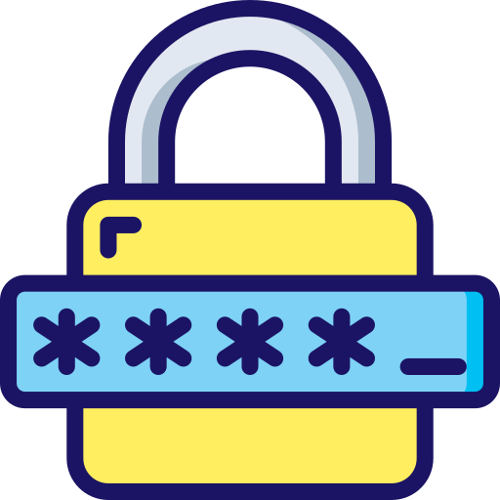
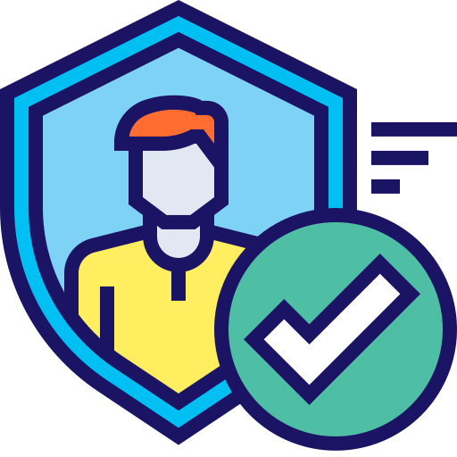
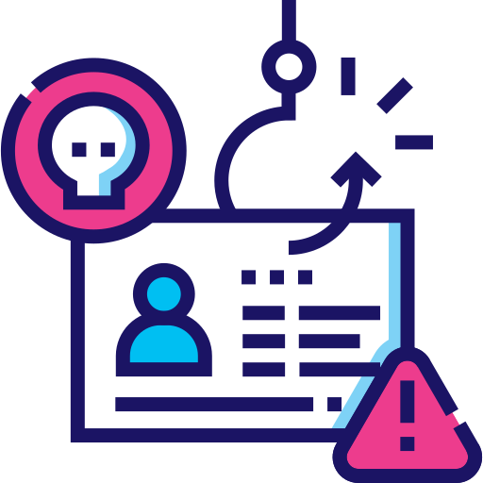
Eight simple actions you can take right now to reduce the cybersecurity risk for both your company and yourself
8 ways to improve your cybersecurity
1.
2.
3.
4.
Use strong passwords and a password manager
Utilize Multi-Factor Authentication when you log into your accounts and never disable it.
Recognize and report phishing
Carefully examine the email address, URL, and spelling used in any correspondence.
Scammers use slight differences to trick your eye and gain your trust.
(.com vs. .net; .kelly vs .kelley)
Access more Information at www.cisa.gov
This information is exclusively provided to VAB members and qualified marketers.
PAGE 7

Slide 8
Eight simple actions you can take right now to reduce the cybersecurity risk for both your company and yourself
8 ways to improve your cybersecurity
5.
6.
7.
8.
Be careful with what you share online or on social media.
Sharing private info like pet names, schools, or your birthday can help scammers guess your password or answer security questions.
Only use trusted sources when downloading anything
from the open web
Never open an attachment from someone you don't know and be wary of email attachments forwarded to you.
Install software updates promptly
Many software updates are created to fix security risks
Access more Information at www.cisa.gov
This information is exclusively provided to VAB members and qualified marketers.
PAGE 8

Slide 9
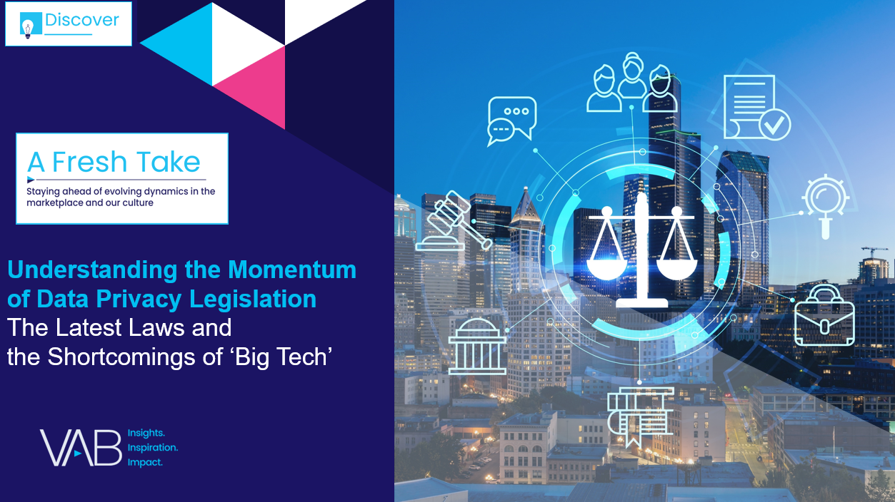
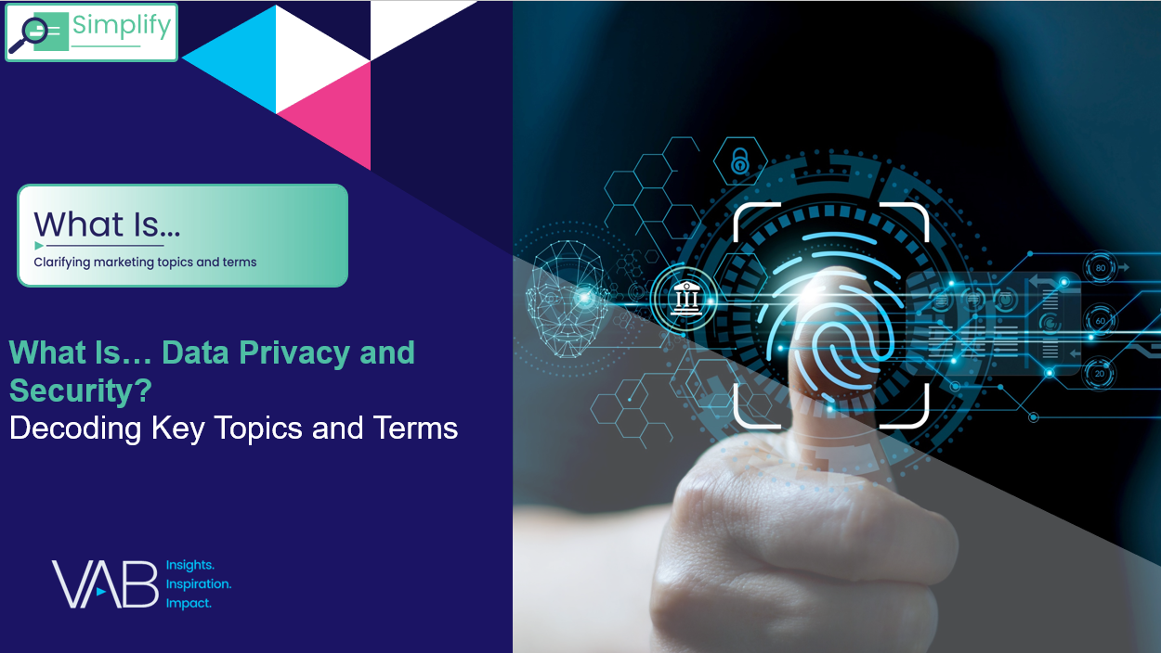
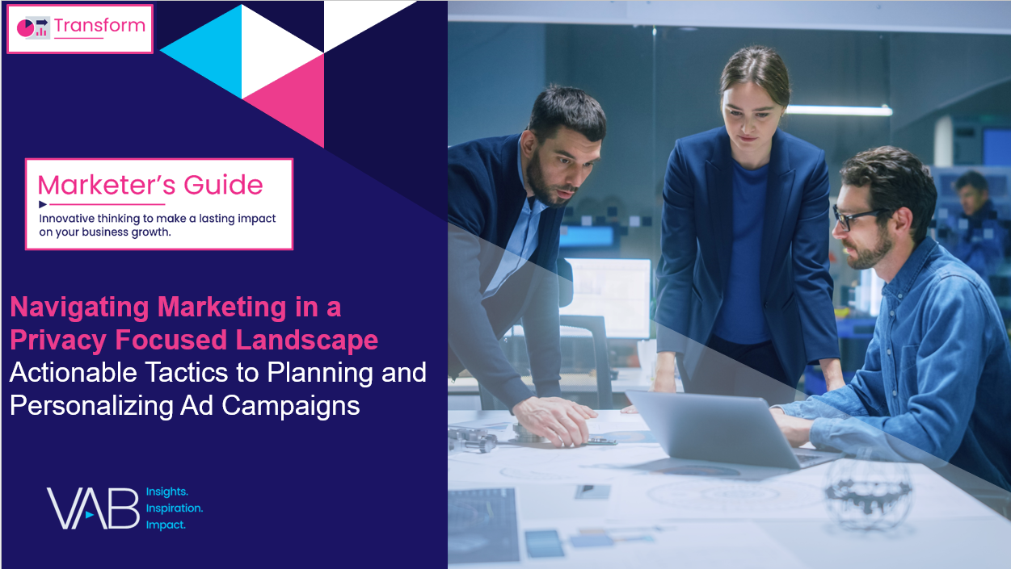
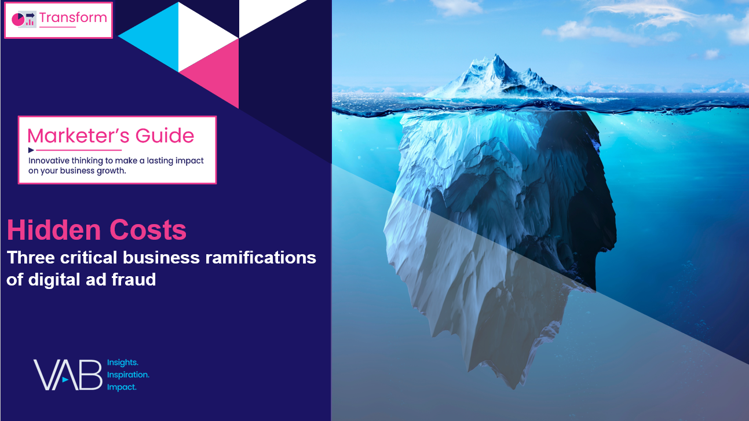
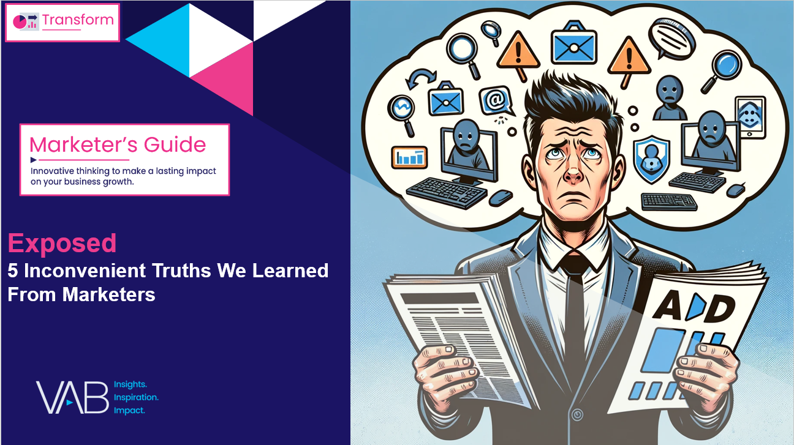
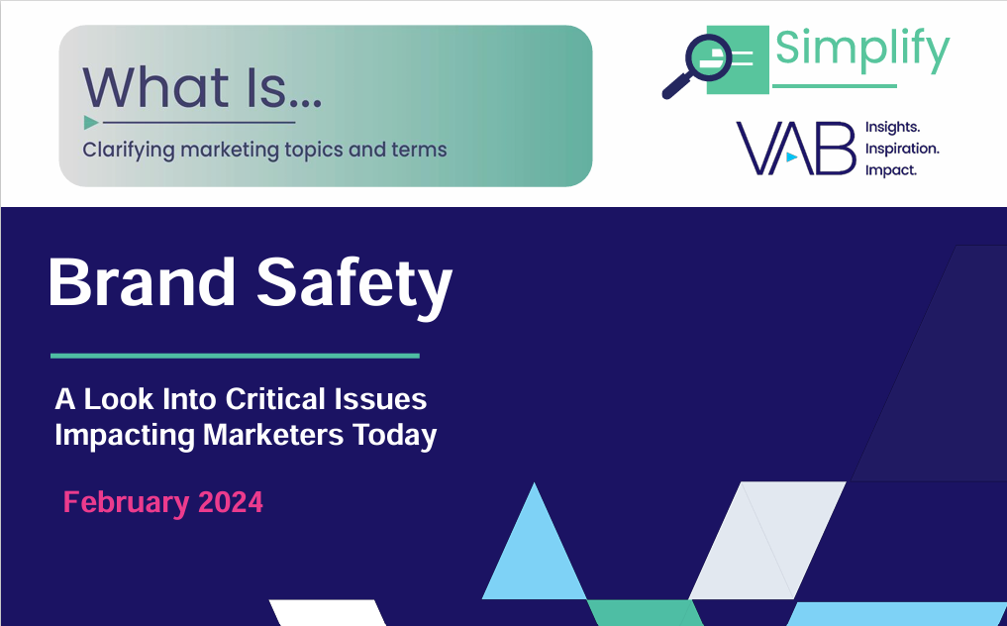
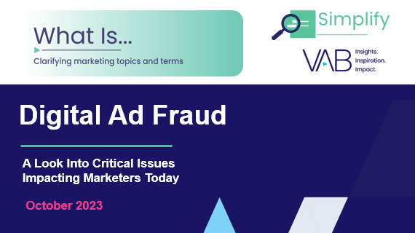
Want more? VAB has a wealth of cybersecurity related resources
Access more Information at www.thevab.com
This information is exclusively provided to VAB members and qualified marketers.
PAGE 9

Slide 10
About VAB
VAB plays a dual role in the video advertising industry. We are leading the change to bring about a more innovative and transparent marketplace. We also provide the insights and thought leadership that enables marketers to develop business-driving marketing strategies.
Drawing on our marketing expertise, we simplify the complexities in our industry and discover new insights that transform the way marketers look at their media strategy.
We are committed to your business growth and proud to offer VAB members, brand marketers and agencies complimentary access to our continuously-growing Insights library. Get immediate access at theVAB.com.
This information is exclusively provided to VAB members and qualified marketers.
PAGE 10

