Slide 1
November 8, 2024
Question of the Week:
“
How do I activate an
Addressable TV campaign?
“

Slide 2
Addressable TV Defined
Addressable TV is:
Video advertising solution where a single message from an advertiser is precisely matched to an advertiser-defined audience segment. This enables different commercials to be targeted to different households on the same TV network at the same time when the viewer is watching.
Addressable TV uses authenticated data and advanced technology to facilitate the targeting of relevant messages to qualified audience segments in adherence to business and consumer privacy compliance requirements.
This information is exclusively provided to VAB members and qualified marketers.
PAGE 2

Slide 3
Five Steps to Activating an Addressable TV Campaign
1
Establish Target Audience
Deterministically match authenticated audience data against first- & third-party segments within the addressable footprint of your media partner
Geographic
Behavioral
First-Party Data Matching
Licensed
Third-Party Data
2
Forecasting
Unlock campaign efficiencies and enhance ad decisioning by leveraging rich historical viewership and audience data
Maximize Reach Potential
Reduce Ad Waste
Refine Target Audiences
Customize
Creative Messaging
3
Campaign Activation
Serve ads to target audiences across multiple premium, brand safe platforms
Cable TV
Satellite
Smart TV / CTV
Mobile / Web Apps
4
Campaign Monitoring & Optimization
Enhance campaign delivery through advanced campaign management and optimization opportunities
Timely Reporting
Reach Management
Frequency Capping
Creative Versioning
5
Post Campaign Reporting
Deterministic data allows for precise and performance-based campaign measurement across multiple dimensions at the household level
Network & Daypart
Audience
Cross Platform
Outcomes
This information is exclusively provided to VAB members and qualified marketers.
PAGE 3

Slide 4
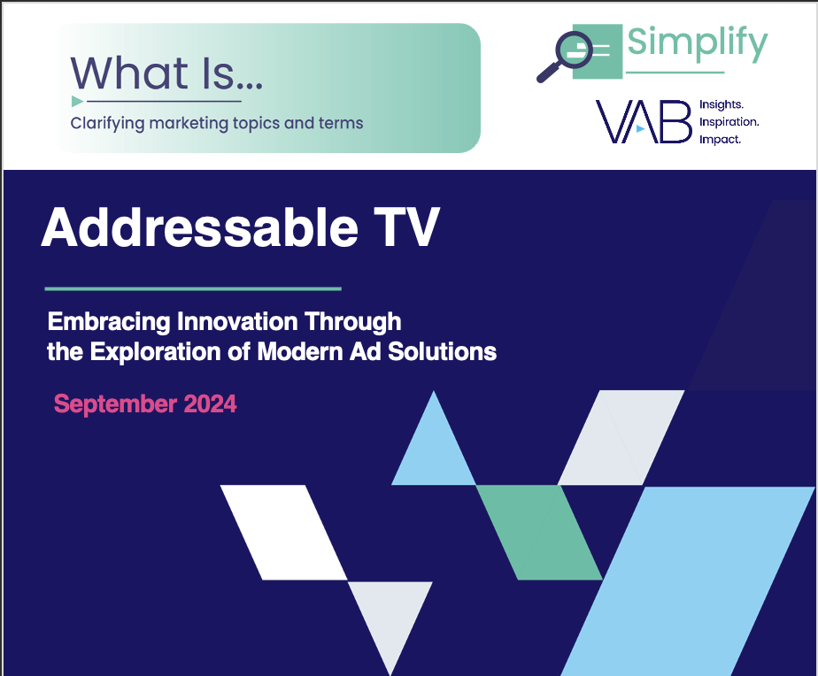
Download our full 12-page report to learn more about Addressable TV and its ability to drive outcomes for advertisers
Click report cover below to download
Access additional insights at www.thevab.com
This information is exclusively provided to VAB members and qualified marketers.
PAGE 4

Slide 5
About VAB
VAB plays a dual role in the video advertising industry. We are leading the change to bring about a more innovative and transparent marketplace. We also provide the insights and thought leadership that enables marketers to develop business-driving marketing strategies.
Drawing on our marketing expertise, we simplify the complexities in our industry and discover new insights that transform the way marketers look at their media strategy.
We are committed to your business growth and proud to offer VAB members, brand marketers and agencies complimentary access to our continuously-growing Insights library. Get immediate access at theVAB.com.
This information is exclusively provided to VAB members and qualified marketers.
PAGE 5

