Slide 1
December 6, 2024
Question of the Week:
“
What type of video content do digital-first cord cutters and nevers prefer to watch?
”

Slide 2
Answer: Even digital-first cord cutters and nevers prefer watching
long-form professionally produced content over non-premium online video
Hours per week spent watching TV Shows & Movies vs. Non-Premium Videos
Among weekly non-premium video content viewers
(10+ hours / week)
Source: Hub Entertainment Research, Video Redefined, January 2024. Based on survey of 1,900 consumers, ages 13-74. ‘Cord Cutter / Never’ respondents = 822 (unweighted); Heavy Online Video Viewer respondents = 660 (unweighted); Mobile Phone Viewer respondents (watch on phone daily) = 905 (unweighted). Data collected December 2023. ‘Non-premium video’ includes short-form or user-generated video on YouTube, influencer video content, etc.
This information is exclusively provided to VAB members and qualified marketers.
PAGE 2

Slide 3
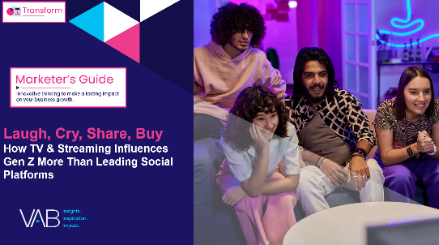
Want to learn more on engagement between TV & Streaming and social media? Check out full custom studies on Gen Z, Hispanic & Black adults
41 pages
22 pages
Laugh, Cry, Share, Buy
How TV & Streaming Influences Gen Z
More Than Leading Social Platforms
The Big Picture
12 Key Charts on the Impact of TV & Streaming vs. Social Media Platforms
32 pages
35 pages
Reir, Llorar, Compartir, Comprar
How TV & Streaming Inspire Deeper Connections with Hispanic Audiences Than Social Media
Unite, Empower, Reflect, Shop
How TV & Streaming Cultivate Richer Interactions with Black Audiences Than Social Platforms
This information is exclusively provided to VAB members and qualified marketers.
PAGE 3

Slide 4
About VAB
VAB plays a dual role in the video advertising industry. We are leading the change to bring about a more innovative and transparent marketplace. We also provide the insights and thought leadership that enables marketers to develop business-driving marketing strategies.
Drawing on our marketing expertise, we simplify the complexities in our industry and discover new insights that transform the way marketers look at their media strategy.
We are committed to your business growth and proud to offer VAB members, brand marketers and agencies complimentary access to our continuously-growing Insights library. Get immediate access at theVAB.com.
This information is exclusively provided to VAB members and qualified marketers.
PAGE 4

